Slide 1









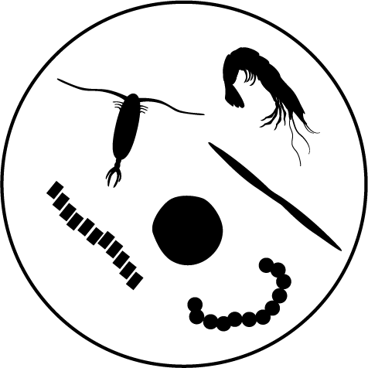
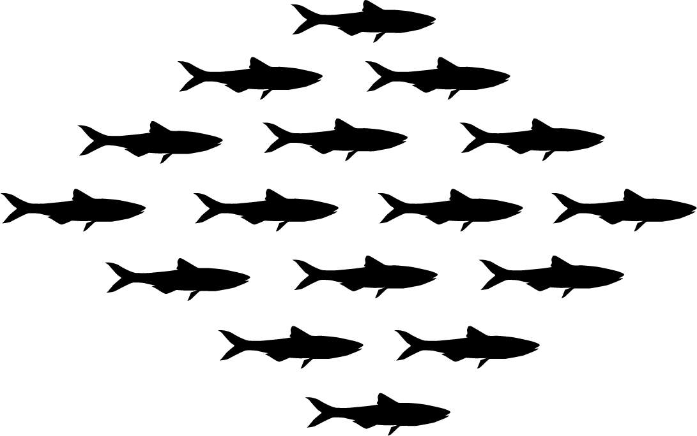

JUVENILE SALMON
ADULT SALMON
e1 yearling
condition
f1 yearling abundance
e2 early subyearling condition
f2 early subyearling abundance
e3 late subyearling condition
f3 late subyearling abundance
g1 spring
g3 fall
PREDATORS
NON-NCC
h1 spring
NON-NCC
h3 fall
d1 birds
d2 pinnipeds
d3 fish predators
d4 killer whales
COMPETITORS
c1 adult forage fish
c2
jellyfish
c3 groundfish
CLIMATE
a1 sea surface temp
PREY
CLIMATE
a3 NPGO, upwelling
b1 juvenile fish
b2 zooplankton
b3 juvenile forage fish

Slide 2







CLIMATE FORCING HYPOTHESIS
MOST IMPORTANT LINKS FOR +/- SALMON OUTCOMES
RESEARCH IMPLICATIONS
H1: Simple bottom-up
Salmon data may be sufficient.
b2 zooplankton
e2 subyearling condition
f1 yearling abundance
d3 fish predators
H5: Bottom-up + all predators
g3 fall adults
Direct responses of predator to climate and benefits from the consumption of salmon needed.
d1 birds
f1 yearling abundance
g1 spring adults
d4 killer whales
H6: All groups
(base)
e2 early condition
e3 late condition
f1 yearling abundance
g3 fall adults
d4 killer whales
H6: All groups (mammal)
Competitor climate sensitivity is also important.
c2 jellyfish
d1 birds
e1 yearling condition
f1 yearling abundance
d2 pinnipeds
c3 groundfish
d3 fish predators
Base network, spring-run adult outcomes (g1)
Notes:
Note to Su: Drop text from under icons
Figure 5. Each of the temperature hypotheses connected different functional groups (icons) directly to climate. Three of the hypotheses are shown here, H1, H8 & H9, with the nodes that were modified in each hypothesis shown in the yellow boxes. Red lines indicate the links that ranked highest in the BRT analysis for spring Chinook for that temperature hypothesis. Curved lines indicate self-limiting parameters on that node. See Supplementary materials for the full list of weights for the top links

Slide 3
Climate change affects salmon through direct and indirect marine food-web pathways
Increased predation & competition
Altering the network structure by adding or removing individual links dramatically changed salmon outcomes
Spring-run
Fall-run
30%
Qualitative network models are valuable tools for refining research and conservation strategies
Certainty of negative impacts to salmon
84%
Notes:
Abstract Effectively modeling the impact of climate change on any population requires careful consideration of diverse pressures. Potential changes in interactions with other species must be accounted for. As communities reassemble and shifts in abundance and distribution cascade throughout ecosystems, cumulative impacts on species of conservation concern need to be explicitly examined. A structured qualitative analysis of alternative responses to climate change across the food web could play a valuable role in the design and interpretation of quantitative models. A particular advantage of qualitative network analysis is the ease with which a wide range of scenarios representing structural and quantitative uncertainties can be explored. We tested 36 plausible representations of connections between salmon and key functional groups within the marine food web using qualitative network models. The scenarios differed in how species pairs were connected (positive, negative, or no interaction) and which species responded directly to climate change. Our analysis showed that certain configurations produced consistently negative outcomes for salmon, regardless of the specific values for most of the links. Salmon outcomes shifted from 30% to 90% negative when consumption rates by multiple competitor and predator groups increased following a press perturbation from climate. This scenario aligns with some recent observations during a marine heatwave. Feedbacks between salmon and mammalian predators were particularly important, as were indirect effects connecting spring- and fall-run salmon. We also identified which links most strongly influenced salmon outcomes in other scenarios. Our results emphasize the importance of structural uncertainty in food webs and demonstrate a tool for exploring it, paving the way for more targeted and effective research planning. 2-3 Sentence summary: This study uses qualitative network models to explore how climate change-driven shifts in marine food web interactions impact salmon populations. By testing 36 scenarios with varying species connections and responses to climate change, the analysis reveals that increased predation and competition consistently lead to negative outcomes for salmon. The findings highlight the importance of structural uncertainty in climate impact studies and provide a valuable tool for refining research and conservation strategies.

